Slide 1

AWS Data Engineering Virtual Internship
by
G. VYSHNAVI
Roll No. 224G1A32B9
Department of Computer Science and Engineering (Data Science)
Srinivasa Ramanujan Institute of Technology
(Affiliated to JNTUA & Approved by AICTE) (Accredited by NAAC with ‘A’ Grade & Accredited by NBA (EEE, ECE & CSE)
Rotarypuram Village, B K Samudram Mandal, Ananthapuramu – 515701.
2025 – 2026

Slide 2



Contents
Data Engineering Virtual Internship
Course Objective
Introduction
Technology
Applications
Modules
Real Time applications
GitHub Link
Queries
224G1A32B9

Slide 3
Course Objective
Data Engineering Virtual Internship
The primary objective of the AWS Data Engineering Virtual Internship is, to develop proficiency in AWS data services by gaining hands-on experience and a deep understanding of core AWS tools such as Amazon S3, Amazon Redshift, AWS Glue, and AWS Lambda.
Participants will learn to design, build, and manage efficient data pipelines while creating and optimizing scalable ETL processes and data workflows. Emphasis will be placed on ensuring data quality, security, and performance to support data-driven decision-making in real-world scenarios.
224G1A32B9

Slide 4
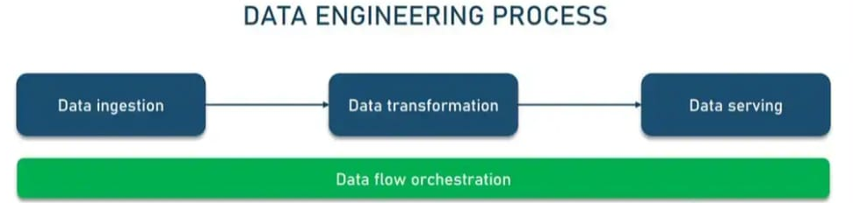
Introduction
Data Engineering Virtual Internship
AWS Data Engineering is the practice of using Amazon Web Services (AWS) to design, build and manage data systems and pipelines that collect, store, process and analyze large volumes of data.
Key activities include:
Data Ingestion and Storage: Collecting data from various sources into AWS storage solutions & Using Amazon S3, Redshift and RDS for efficient data storage.
Data Processing: Transforming data using AWS Glue and ETL processes.
224G1A32B9

Slide 5
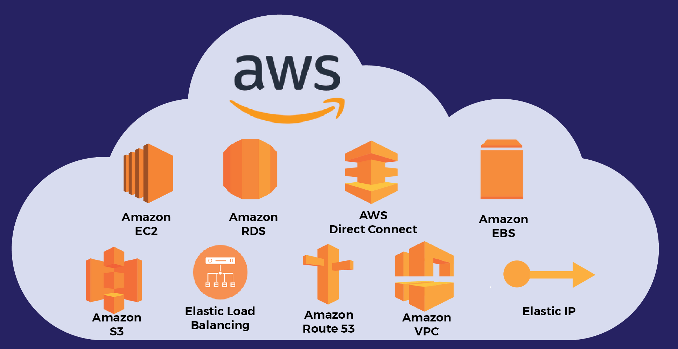
Contd…
Data Engineering Virtual Internship
Data Quality and Analysis: Ensuring data integrity, accuracy, analyzing and visualizing data with tools like RedShift Spectrum, Athena and Quick Sight.
Automation and Optimization: Automating workflows with AWS Lambda and optimizing system performance.
224G1A32B9

Slide 6
Data Processing
Data Engineering Virtual Internship
Big Data Processing
Big data processing involves handling large volumes of structured, semi-structured, and unstructured data to extract insights, patterns, and trends. Here are some key aspects of big data processing:
Types of Big Data Processing
Batch Processing: Processing large datasets in batches, often using distributed computing frameworks like Hadoop or Spark.
Real-time Processing: Processing data as it is generated, often using stream processing frameworks like Apache Kafka, Apache Flink or Apache Storm.
Interactive Processing: Processing data in response to user queries, often using interactive query engines like Apache Hive, Apache Impala or Presto.
224G1A32B9

Slide 7
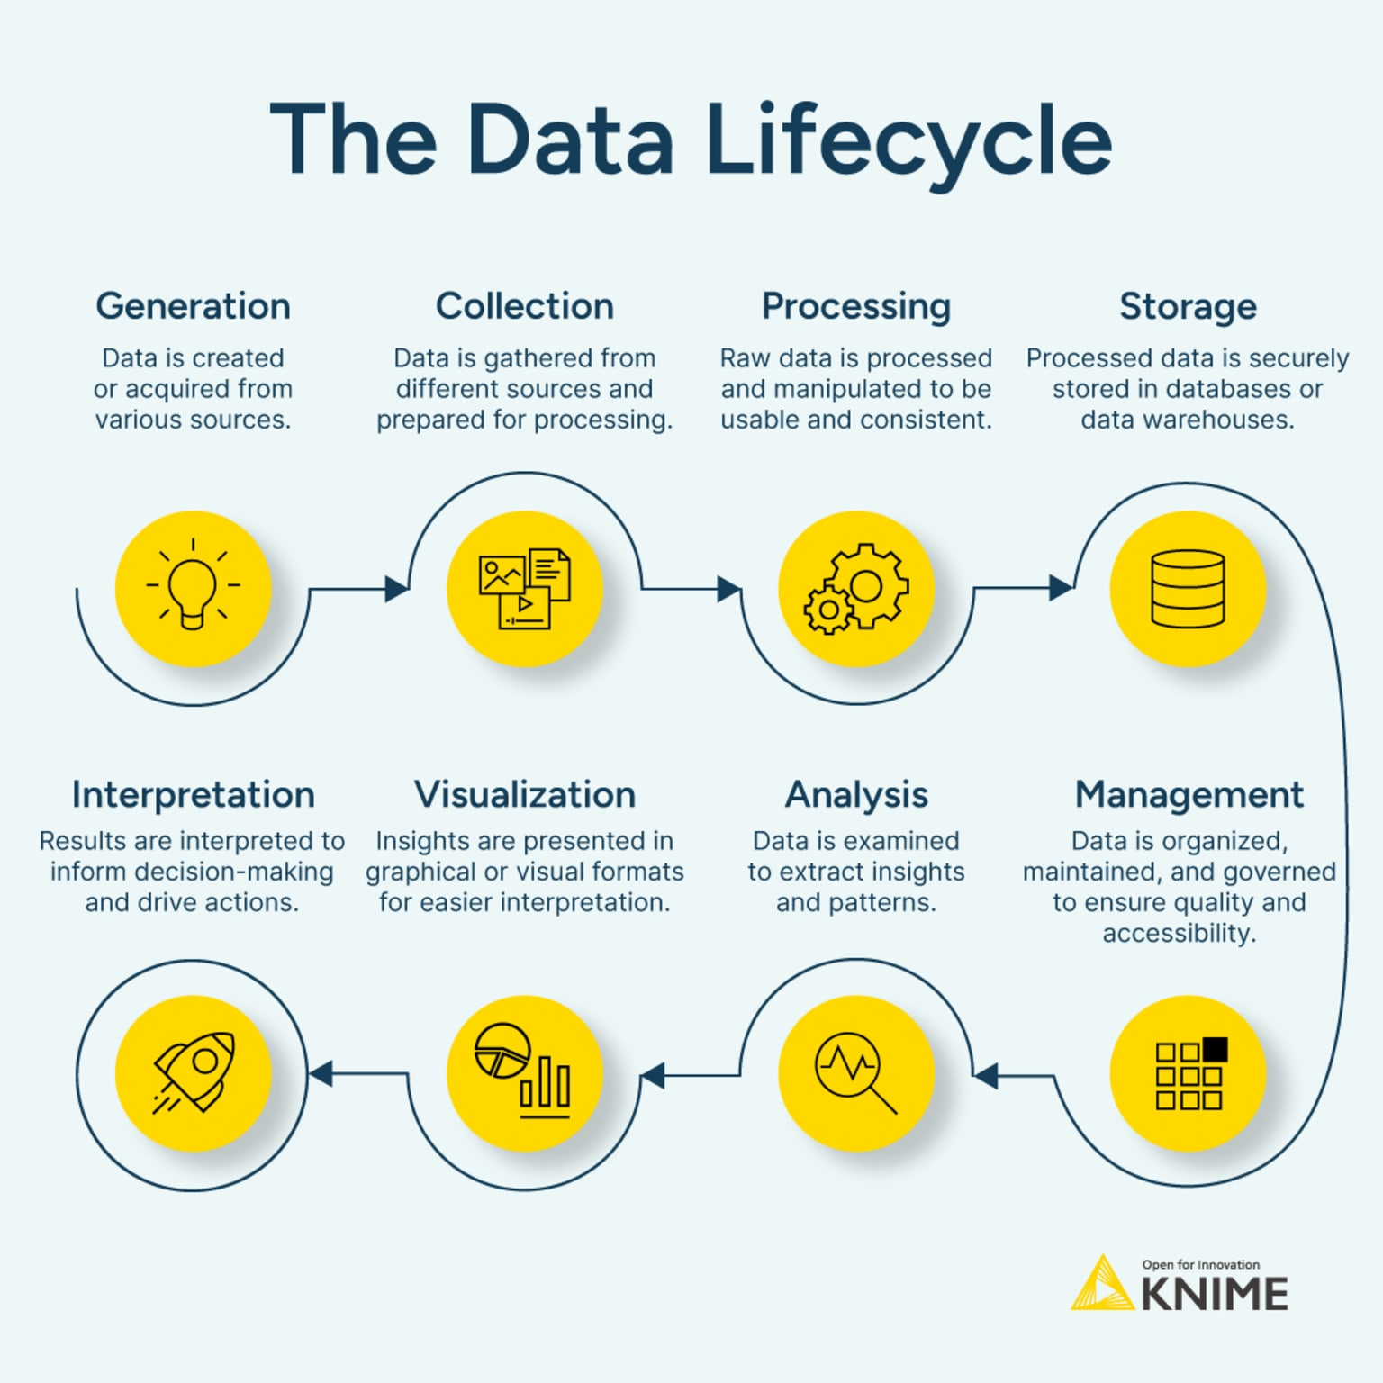
Data Processing LifeCycle
Data Engineering Virtual Internship
224G1A32B9

Slide 8
Technologies:
Data Engineering Virtual Internship
Amazon S3 (Simple Storage Service): Scalable object storage for storing and retrieving large amounts of data.
Amazon Redshift: Data warehouse service for analyzing large datasets with high-performance SQL queries.
Amazon RDS (Relational Database Service): Managed relational databases including MySQL, PostgreSQL, SQL Server, and Oracle.
AWS Glue: Managed ETL (Extract, Transform, Load) service for preparing and transforming data.
Amazon Athena: Interactive query service that allows you to analyze data directly in Amazon S3 using SQL.
224G1A32B9

Slide 9
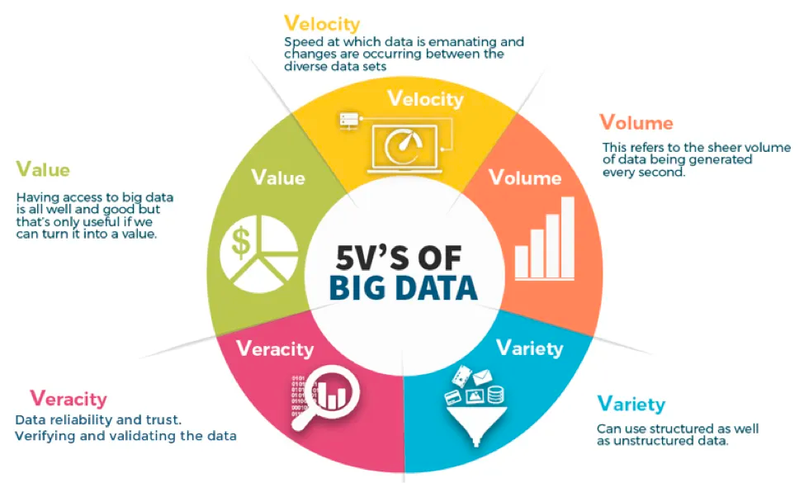
The 5 V’s
Data Engineering Virtual Internship
224G1A32B9

Slide 10

Real Time Applications
Data Engineering Virtual Internship
Real-Time Updates: Engage with consumers, gamers, financial traders, and more by providing real-time updates to critical decision-making metrics, offer recommendations, and customer experiences.
Clickstream Analytics: Get a real-time view of the performance of your web content and user interaction with your applications and websites, including user behavior, amount of time spent, popular content, and more.
IoT Data Processing: Connect to hundreds of thousands of IoT devices and collect, process, and analyze the streaming data in real-time to optimize food production, monitor equipment, or track logistics.
224G1A32B9

Slide 11
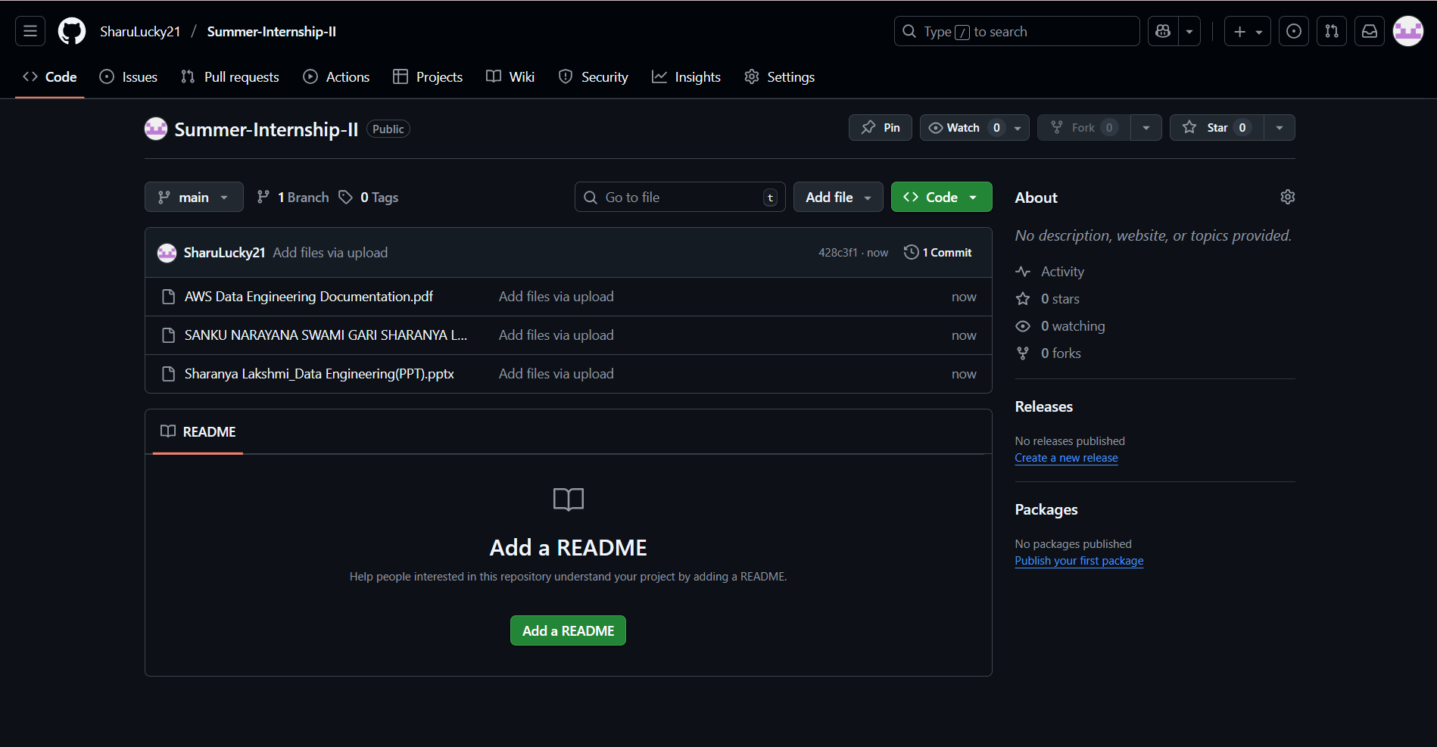
Git Hub Dashboard
Data Engineering Virtual Internship
Repository Name : SUMMER-INTERNSHIP-2
Git Hub Link: https://github.com/Vyshnavig26
224G1A32B9

Slide 12
Data Engineering Virtual Internship
Any Queries?
224G1A32B9

Slide 13
Data Engineering Virtual Internship
Thank You!!!
224G1A32B9

